Slide 1
GER’S GARAGE
FABIO PIMENTEL

Slide 2
Project Overview
Synopsis
Computing General Areas
Project Reason
Use Case

Slide 3
Progress Details

Slide 4
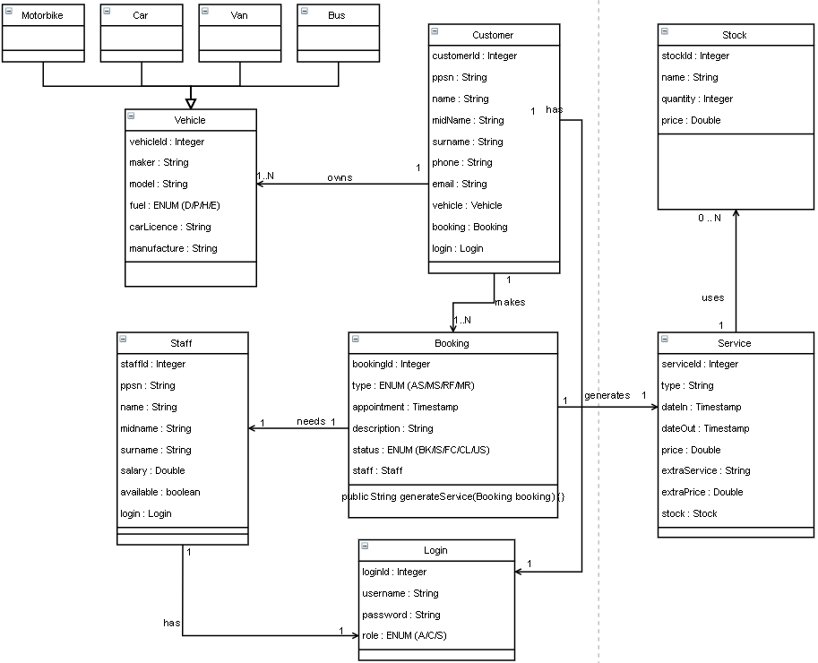
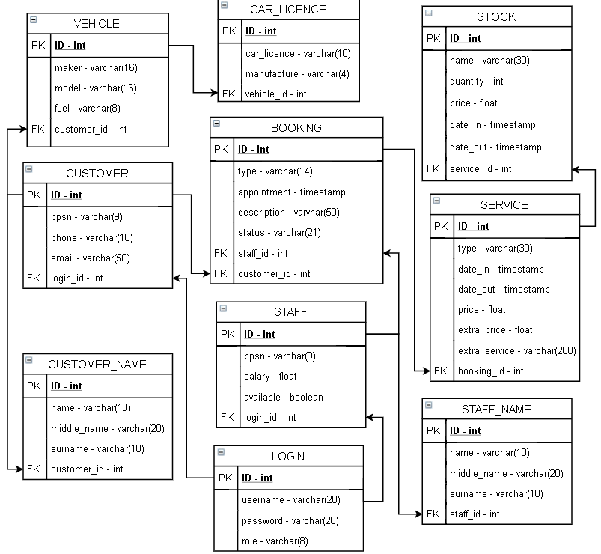
Progress Details

Slide 5
NEXT STEPS
Implement core business
Test Application
Create Report Document

